Slide 1
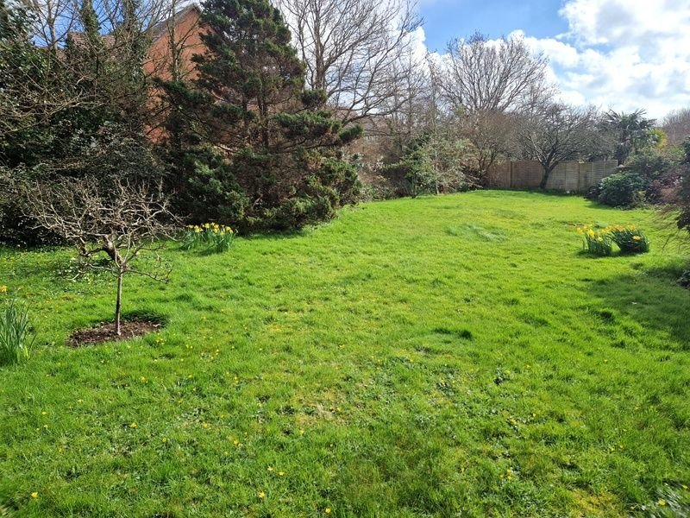
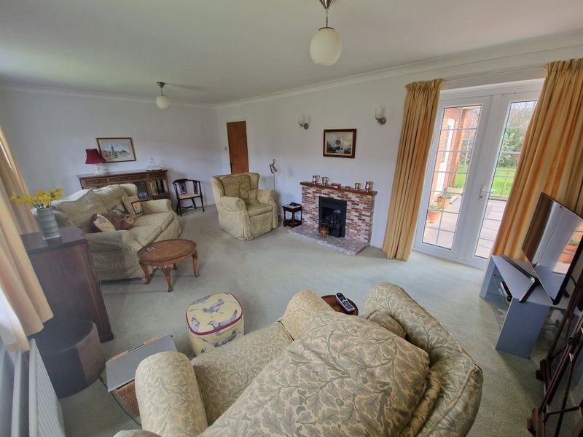
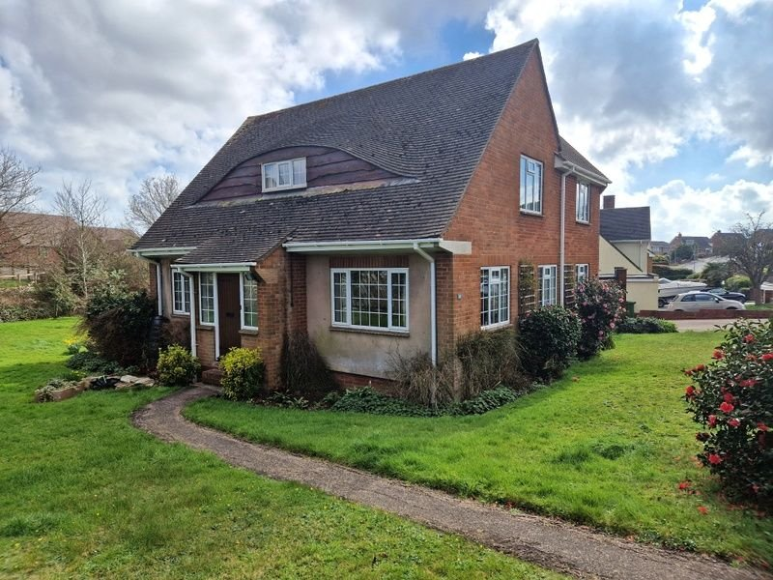
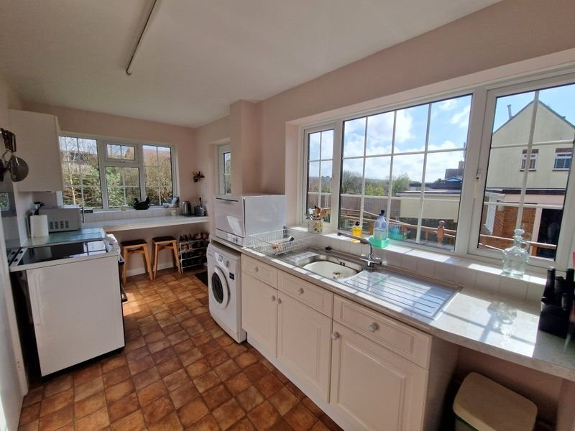
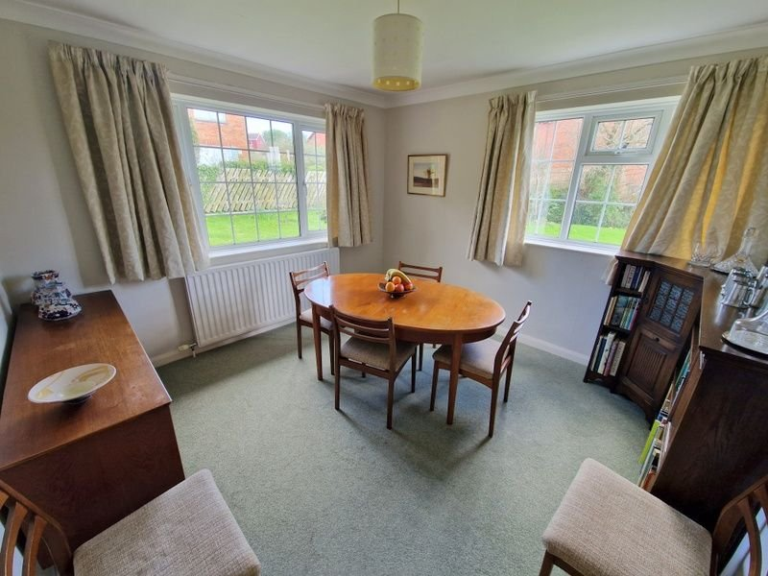
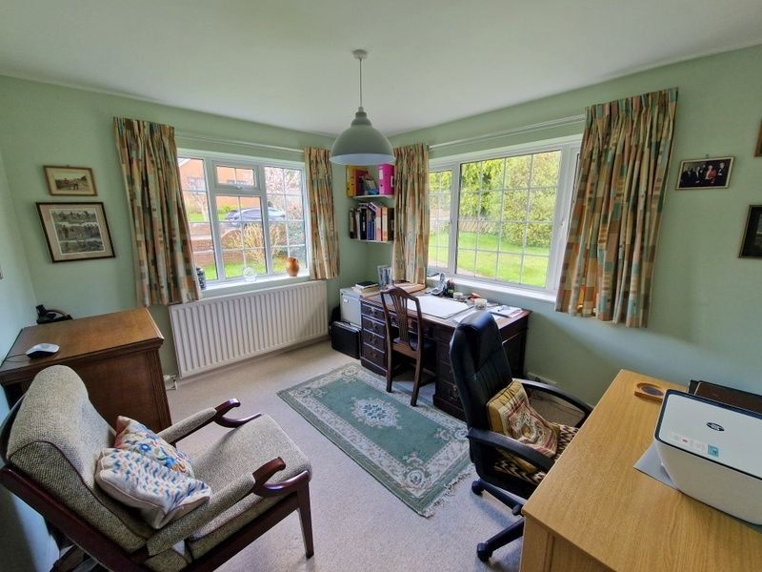
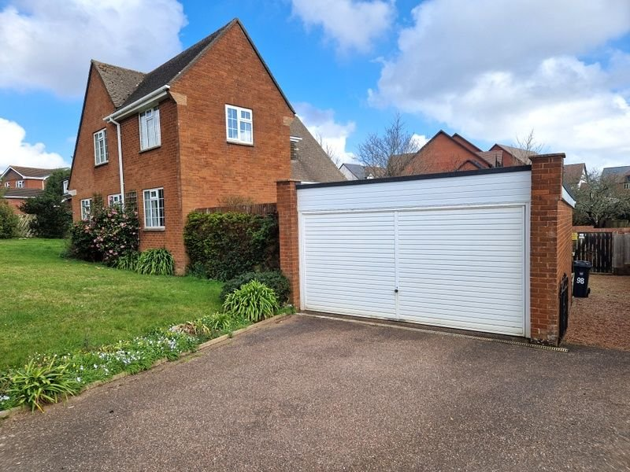
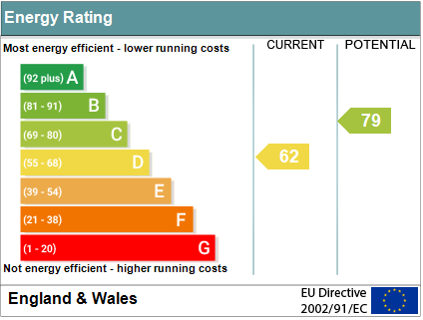
www.pennys.net
98 Douglas Avenue, Exmouth, EX8 2HG
GUIDE PRICE £685,000
TENURE Freehold
A Most Attractive Detached House Standing In Generous Gardens With Double Garage Located In The Favoured Avenues Area Of Exmouth
Entrance Porch & Reception Hall • Lounge • Separate Dining Room •
Kitchen/Breakfast Room • Ground Floor Bedroom Four/Study •
Cloakroom/WC • Three First Floor Bedrooms • Modern Shower Room & Separate W/C •
Double Glazed Windows • Gas Central Heating Via Modern Boiler •
Close To Shopping Parade • Viewing Recommended •
Pennys Estate Agents Limited for themselves and for the vendor of this property whose agents they are give notice that:- (1) These particulars do not constitute any part of an offer or a contract. (2) All statements contained in these particulars are made without responsibility on the part of Pennys Estate Agents Limited. (3) None of the statements contained in these particulars are to be relied upon as a statement or representation of fact. (4) Any intending purchaser must satisfy himself/herself by inspection or otherwise as to the correctness of each of the statements contained in these particulars. (5) The vendor does not make or give and neither do Pennys Estate Agents Limited nor any person in their employment has any authority to make or give any representation or warranty whatever in relation to this property.
PENNYS ESTATE AGENTS
2 Rolle House, Rolle Street, Exmouth, Devon, EX8 2SN
Tel: 01395 264111 EMail: help@pennys.net

Slide 2
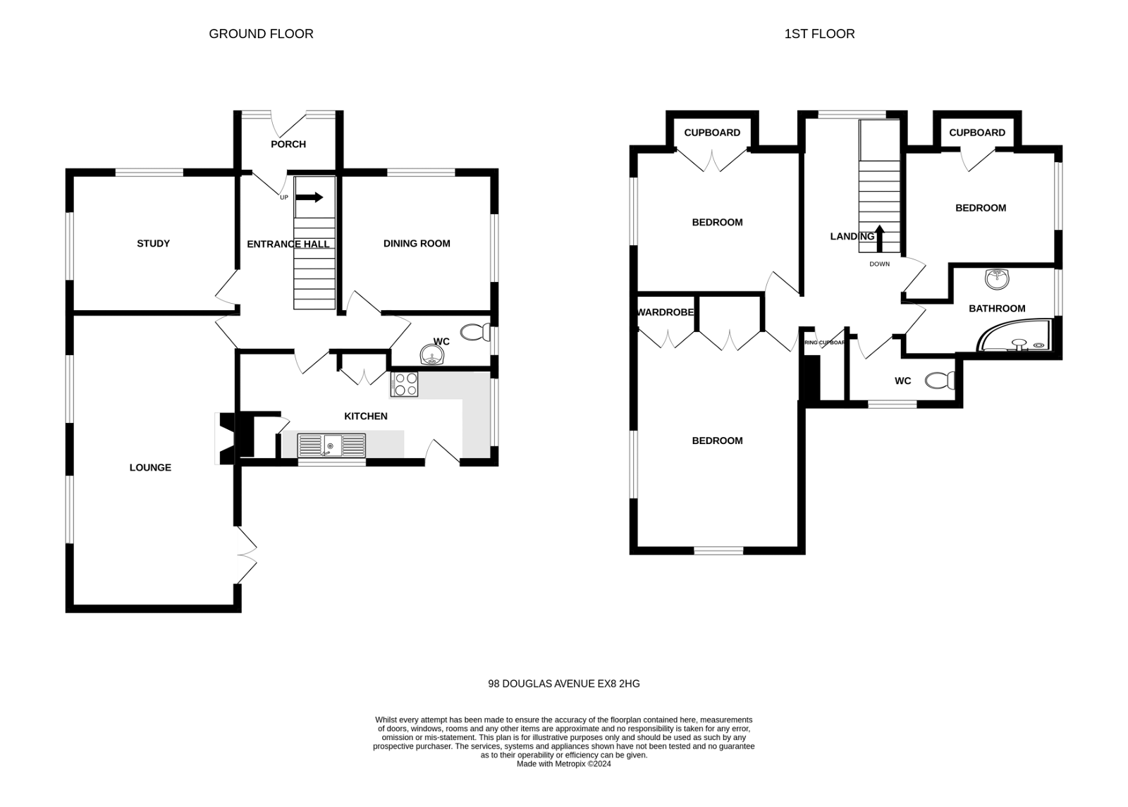
98 Douglas Avenue, Exmouth, EX8 2HG
THE ACCOMMODATION COMPRISES: Solid wood front door to: ENTRANCE PORCH: Two uPVC double glazed windows; inner glazed door to: RECEPTION HALL: Radiator; stairs to first floor landing with useful understairs cupboard beneath. CLOAKROOM/WC: WC with push button flush; pedestal wash hand basin; uPVC double glazed window with pattern glass. LOUNGE: 6.35m x 3.61m (20'10" x 11'10") A spacious bright room with two uPVC double glazed windows to side aspect and uPVC double glazed double doors to REAR SUN TERRACE; television point; two radiators; stone fireplace housing living flame coal gas effect gas fire. DINING ROOM: 3.35m x 3.3m (11'0" x 10'10") A dual aspect room with two uPVC double glazed windows overlooking front and side aspects; radiator. KITCHEN/BREAKFAST ROOM: 5.61m x 2.44m (18'5" x 8'0") Maximum overall measurement. Comprising of pattern worktop surfaces with inset double drainer sink unit with cupboards, drawer units, plumbing for an automatic washing machine and appliance space beneath; breakfast bar; electric cooker point; shelved larder cupboard also housing electric meter and consumer unit; shelved pantry ; modern gas boiler; radiator; two uPVC double glazed windows overlooking side and rear aspects; uPVC double glazed door to outside. GROUND FLOOR BEDROOM FOUR/STUDY: 3.73m x 3.07m (12'3" x 10'1") Two uPVC double glazed windows to front and side aspects; radiator. FIRST FLOOR GALLERIED LANDING: uPVC double glazed window to front aspect; access to roof space; airing cupboard with water tank and shelving. BEDROOM ONE: 4.27m x 3.63m (14'0" x 11'11") A fine main bedroom with two uPVC double glazed windows to side and rear aspect; two built-in wardrobes; radiator. BEDROOM TWO: 3.66m x 3.18m (12'0" x 10'5") uPVC double glazed window to side aspect; radiator; built-in cupboard. BEDROOM THREE: 3.35m x 2.57m (11'0" x 8'5") uPVC double glazed window to side aspect; radiator; built-in cupboard. SHOWER ROOM: 3.4m x 1.88m (11'2" x 6'2") With large shower cubicle with splash screen and splash back walls; pedestal wash hand basin; shaver socket; radiator with heated chrome heated towel rail attached; extensively tiled walls; uPVC double glazed window. SEPARATE W/C: WC; uPVC double glazed window with pattern glass.
OUTSIDE: The property is approached via either a wide tarmac driveway providing access to the detached DOUBLE GARAGE or a pedestrian gate with a pathway leading across the front lawns to the front door. The front garden is predominantly laid to lawn behind a low-level brick wall with a variety of shrubs and pond. The lawns then sweep around the side of the house to the rear garden which remains lawned with mature hedgerows and well stocked borders. A paved terrace sits to one side of the house leading off the sitting room and kitchen and enjoys the lion's share of the afternoon sun with a gentle slope leading down to the gardens. There is an outside tap and outside light.
DOUBLE GARAGE: 18,8 X 16'1 (5.69m X 4.9m) Accessed via electric door; power and light connected; obscure glazed window to rear aspect with pedestrian door to patio area.
FLOOR PLAN:

